Slide 1


7th Grade Advanced Courses:
Get the Facts
Fairhope Middle School

Slide 2

7th Grade Advanced Classes
The advanced classes are an exciting opportunity to prepare students for higher level high school courses.
All advanced class students must have signed parent permission letters.
The commitment for Advanced classes is for the full school year. There will be no schedule changes.
A’s, B’s, and C’s are acceptable grades at Fairhope Middle School. Please do not ask for conferences with teachers if your student is making these grades. If your student is not meeting your expectations with these grades, please work with your student to determine how he/she may improve to your standards.
Please encourage your students to use their planners and check them on a regular basis to see that they are writing down their assignments.
To stay updated on events, activities, and what’s going on at FMS, please check the school website at least weekly.

Slide 3

How Many Advanced Classes At A Time? One, Two, Three, or None?
➔Just because a student qualifies for all 3 advanced classes (English, Math, and Science) does not necessarily mean that he/she needs to take all three.
➔Every student is different. The decision to take any Advanced class should not depend on whether the student qualifies. How willing is your student to put forth the required effort? How self-motivated is your student? Will your student have the time to enjoy and benefit from extra-curricular activities while taking one, two, or three Advanced classes? How has your student done in the past? Have you had to spend excessive time monitoring his/her academic performance? How organized is your student?
➔Talk to your student about what is best, and carefully consider this together.

Slide 4

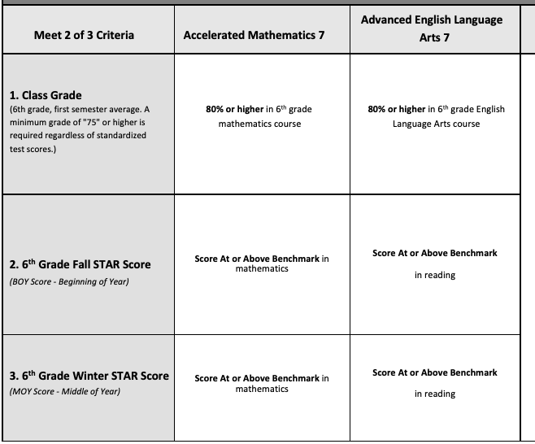
Minimum Criteria for Identification- English and Math
NOT RECOMMENDATION

Slide 5
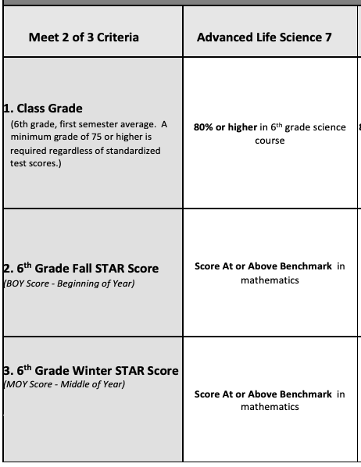
Minimum Criteria for Identification-
Science
NOT RECOMMENDATION

Slide 6

What is the Advanced Curriculum?
All Advanced courses address the Alabama Course of Study as well as College and Career Readiness Standards. Each course curriculum is enriched through the use of A+ College Ready / Laying the Foundation practices.

Slide 7

How are the Advanced
Courses Different?
Students will be learning the same material, but in greater depth and at a faster, more challenging pace.
Students will have extended academic responsibilities and expectations. Students will have outside independent work expectations. Is your student able to work independently?
A student’s work ethic and motivation should be deciding factors when considering advanced classes. Being “smart” or “capable” are not enough!

Slide 8

How are Advanced Courses Beneficial?
Participating in Advanced Courses in middle school will better prepare students for the content and expectations of Pre-AP/AP/IB courses when they transition to high school.
Students will have the opportunity to develop self-discipline and time management skills necessary for academic success.

Slide 9


Can My Student Get Additional Help?
Students should talk with their teachers if they need additional help. Many teachers offer help during break.
Encourage your child to advocate for themselves if they need help.
There is no remediation available
for students who take advanced classes.
Peer tutoring is available if needed.

Slide 10

Things to think about…
Grades may be lower than they were in regular classes, but it is better to adjust now.
Students will have increased independent/ outside of class assignments.
Students should take ownership of their learning and advocate for themselves.
Students involved in multiple extracurricular activities will need to purposefully schedule time to complete their assignments and to study.

Slide 11

Where are Assignments/Due Dates posted?
Each teacher posts Assignments/Due Dates in the classroom and students are responsible for copying them into their agenda.
Google Classroom
Remind (Text app)

Slide 12

Important Reminders
Grade Categories in PowerSchool:
  Formative/Summative Assessments (60%)
  Inside of Classwork (40%)
Teachers are communicating and working as a team to try to be sure that major tests and project due dates do not occur on the same day.

Slide 13

More….Important Reminders
Assignments will not be accepted after the due date.
No partial credit for late work.
No extra credit assignments.
Plagiarism is cheating and will result in a ‘0’ and disciplinary action.
Homeroom time is more structured this year. Students should not plan on using this time to complete work that is due that day.

Slide 14

How can you help at home?
Homework Time:
  Provide a designated, quiet space that allows your student to focus
  Limit cell phone, TV, and other distractions
Encourage self-advocacy skills
Support independent thinking
Emphasize the importance of time management & planning.
Have supportive academic expectations

Slide 15

NJHS Requirements
The National Junior Honor Society (NJHS) GPA requirement is a 3.75.
Advanced course grades in middle school are not weighted.

Slide 16

7th Grade Accelerated Math
Students will be required to show work
Grade 7 Accelerated Math is a compacted course, which means that all of the content of Grade 7 Mathematics, half of Grade 8 Mathematics, and some standards from Algebra I with Probability are compressed into this single course. It is very fast paced and rigorous.
Grade 7 Accelerated Math is a pre-requisite for Grade 8 Accelerated Math. The Grade 8 Accelerated Math will not count as a high school credit.

Slide 17

Advanced English
The curriculum moves at an accelerated pace with a more concentrated focus on independent reading, writing, analysis, and problem solving.
Opportunities are provided for students to develop questioning and research strategies that assist them in organizing and presenting information in oral, visual, and written formats.
Advanced English classes will have a dual focus; an in-depth approach to reading and interpreting literature in various genres and an emphasis on reading strategies to help master required skills, as well as a scaffold approach to the usage of grammar and mechanics through writing practices.
Students will have at home reading assignments.

Slide 18

7th Advanced Science
Students will study an overview of life science including scientific methodology, human body, cells, DNA, genetics, disease, classification, organisms, ecology and more.
Class activities will include participating in class demonstrations and investigations, lectures with note-taking, watching science video clips, lab activities, and more.
The science curriculum consists of LTF (Laying the Foundation) infused lessons.

Slide 19

7th Gifted Civics/Geography
We do not have an “Advanced Placement” for Civics/Geography.
Only students that have qualified for the Gifted Program will take the Gifted Civics and Geography.
If your student is in the Gifted Program for 6th grade, they will automatically be placed in the Gifted Civics/Geography.
Please see the Curriculum Updates page of our school website for more info. https://www.bcbe.org/domain/466

Slide 20

Questions?

